Slide 1
APPROXIMATE HYBRID EQUIVALENT
CIRCUIT

Slide 2
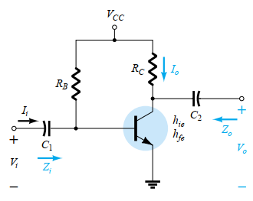
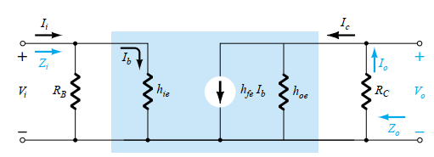


Fixed-Bias Configuration
For the fixed-bias configuration, the small-signal ac equivalent network appears as shown below using the approximate common-emitter hybrid equivalent model
=
Zi: Zo;
:

Slide 3
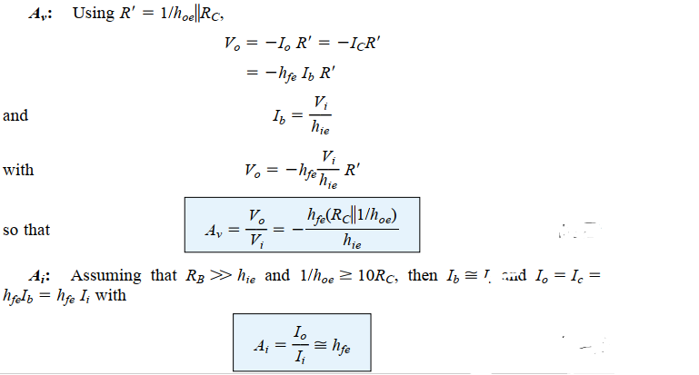

Slide 4
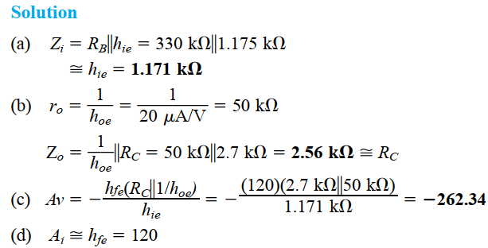
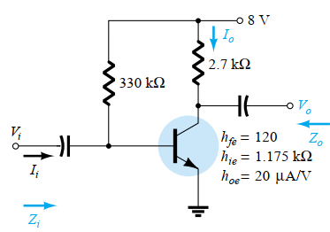
For the network below determine;
(a) Zi.
(b) Zo.
(c) Av.
(d) Ai
.

Slide 5
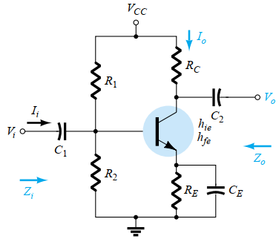
Voltage-Divider Configuration
For the voltage-divider bias configuration, the resulting small-signal ac equivalent network is as appears below, with RB replaced by R’=R1//R2.
=

Slide 6


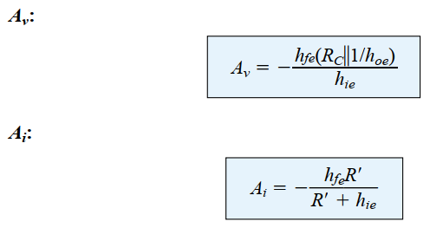
Zi: From the above figure with RB = R’
Zo: From the above figure

Slide 7
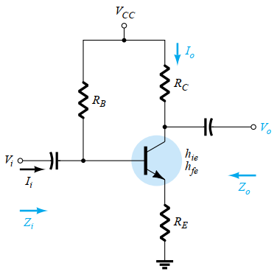
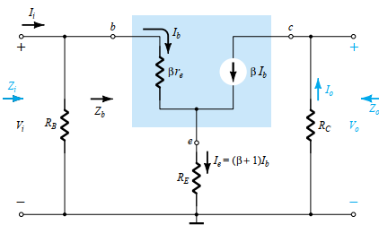
Unbypassed Emitter-Bias Configuration
For the CE unbypassed emitter-bias configuration shown below, the small-signal ac model will be the same as Figure below, with βre replaced by hie and βIb by hfeIb. The analysis will proceed in the same manner.
=

Slide 8
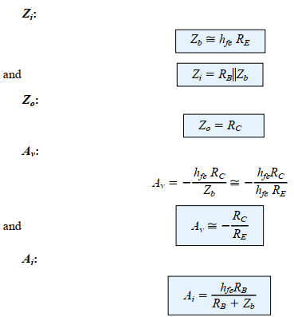


Slide 9
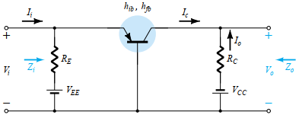
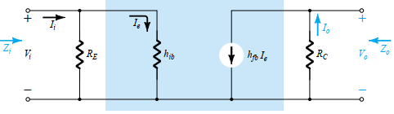
Common-Base Configuration
The last configuration to be examined with the approximate hybrid equivalent circuit is the common-base amplifier
=

Slide 10
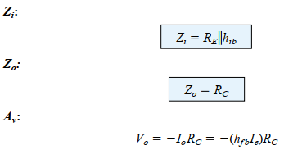
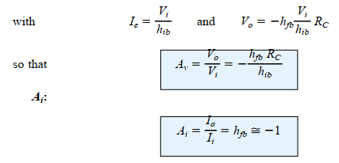

Slide 11
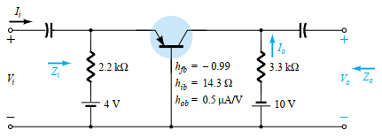
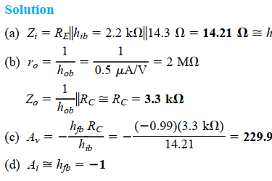
For the network below, determine:
(a) Zi.
(b) Zo.
(c) Av.
(d) Ai

Slide 12
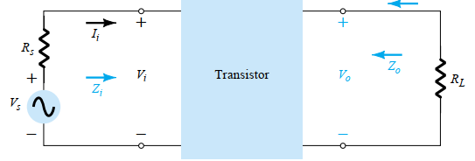
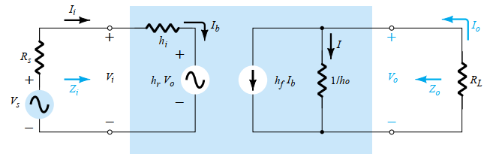
COMPLETE HYBRID EQUIVALENT MODEL
Consider the general configuration of Fig. at the top with the two-port parameters of particular interest and the substituted complete hybrid equivalent model on fig. at the bottom

Slide 13
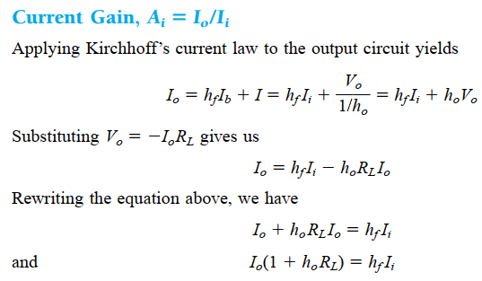

Slide 14
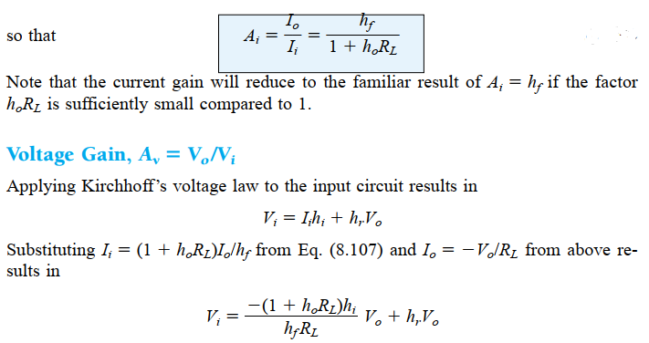

Slide 15
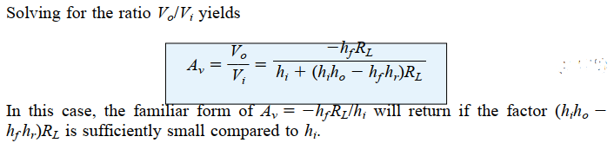

Slide 16
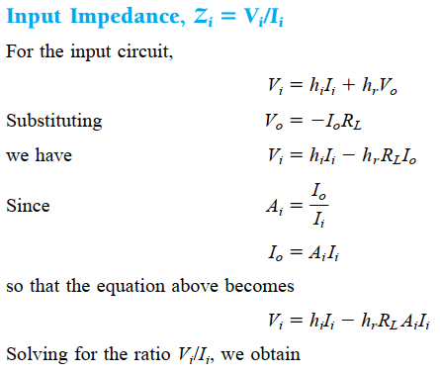

Slide 17
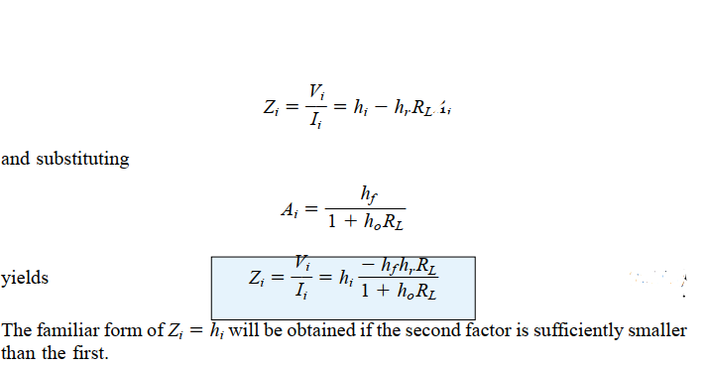

Slide 18
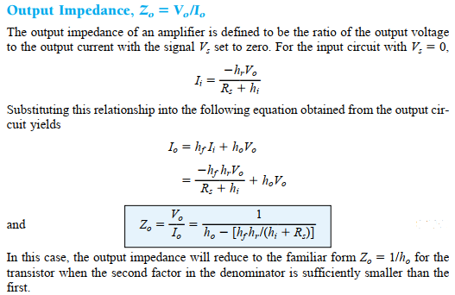

Slide 19
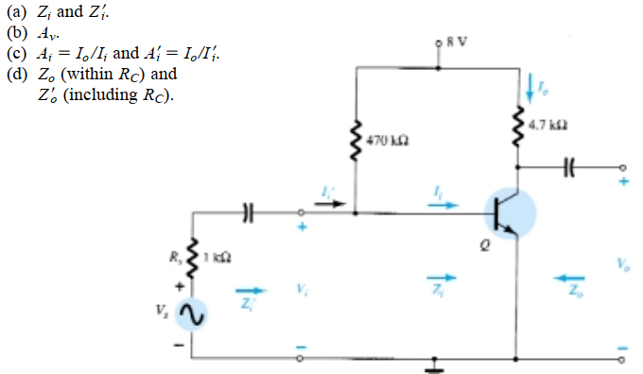

Example;
For the network of figure below, determine the following parameters using the complete hybrid equivalent model and compare to the results obtained using the approximate model.

